Slide 1

On Calibration of Modern Neural Networks
Citation 4294
ICML 2017

Slide 2
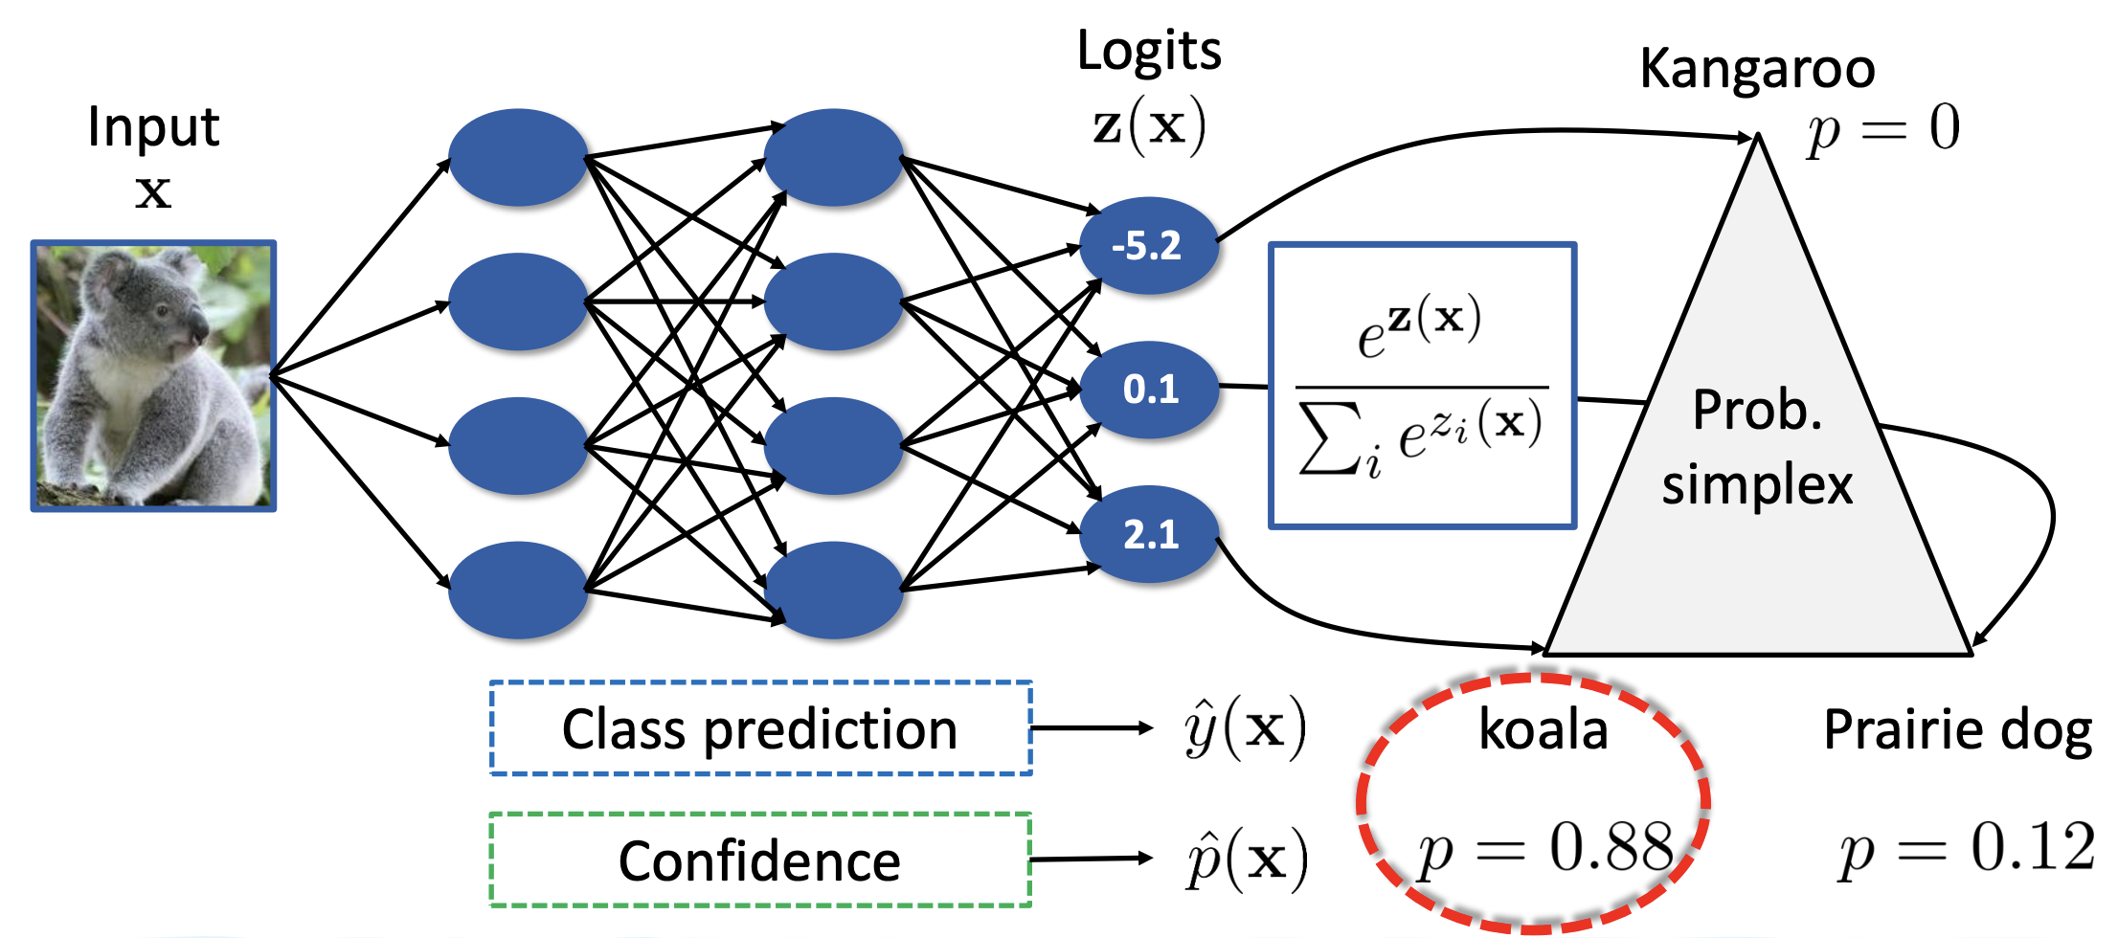
Motivation
In most cases, we only care about the accuracy without considering the confidence.

Slide 3
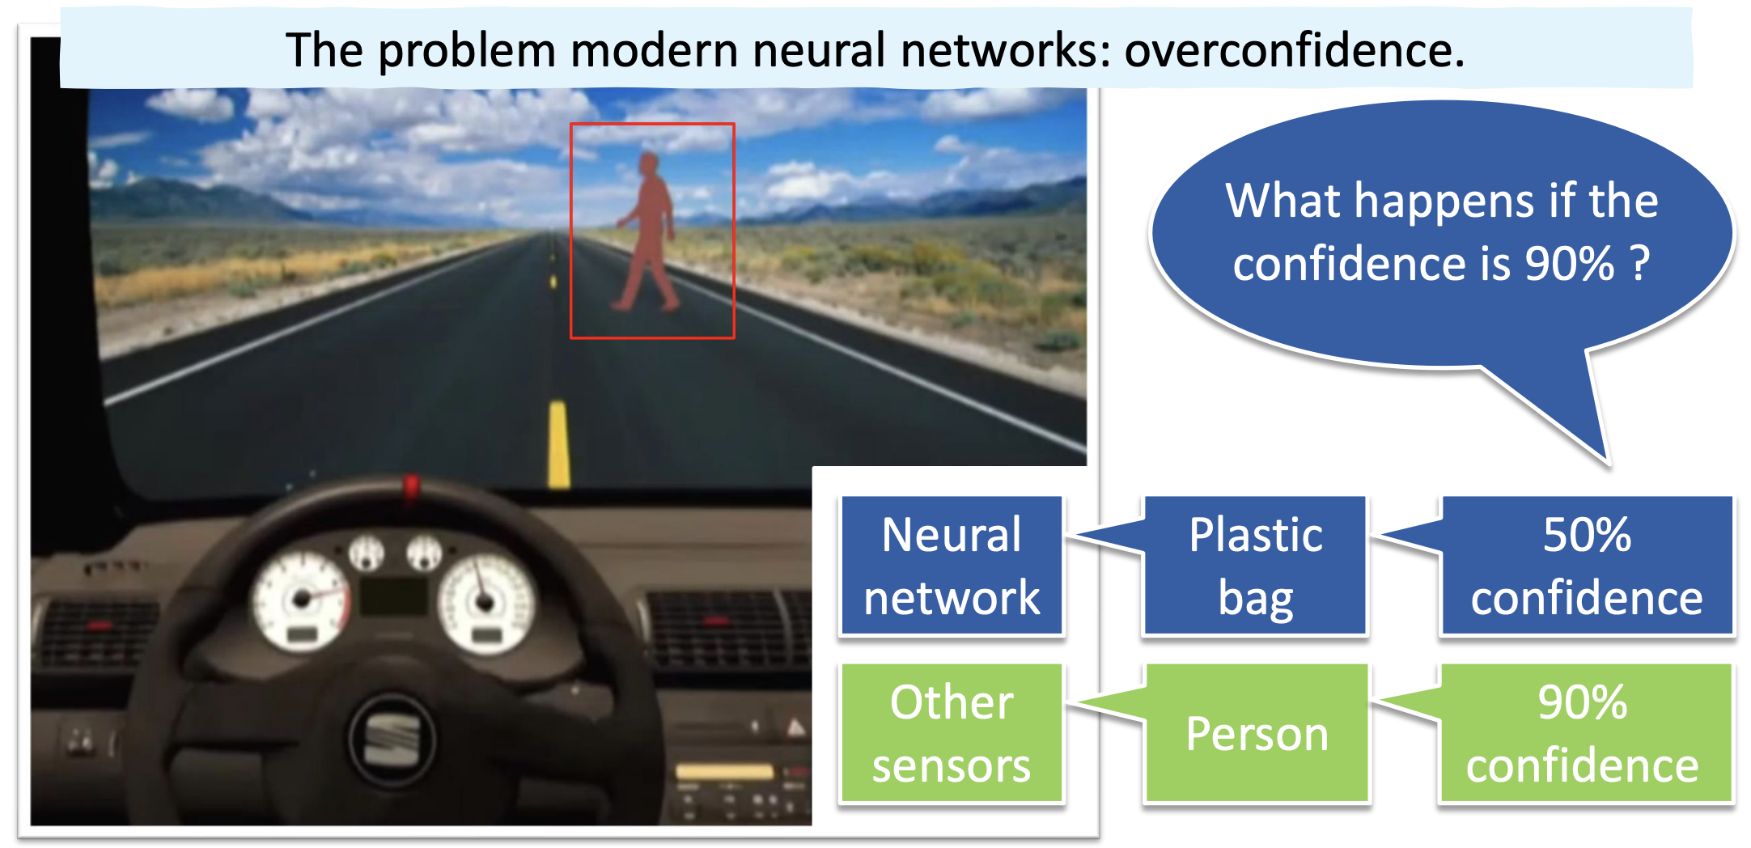
Motivation
Confidence measures could be important in some real scenarios.

Slide 4
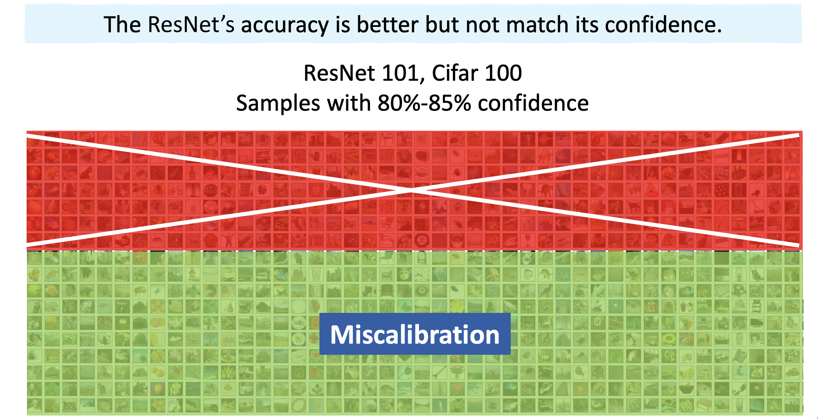
Motivation
Overconfidence phenomenon occurs in DNNs.

Slide 5
Motivation
Problems
Overconfidence (Miscalibration) phenomenon.
Confidence measures could be important in some real scenarios.
Questions
How can we define/measure/visualize miscalibration?
What makes DNNs mis-calibrated?
How can we correct miscalibration?

Slide 6
The first question
How can we define/measure/visualize miscalibration?

Slide 7
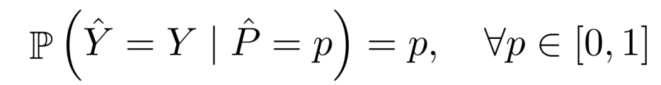
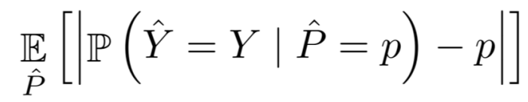
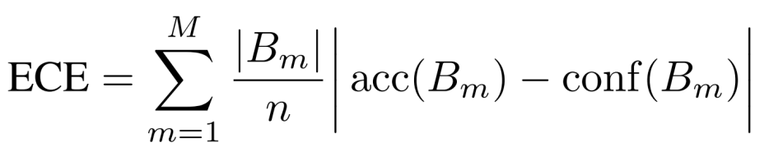
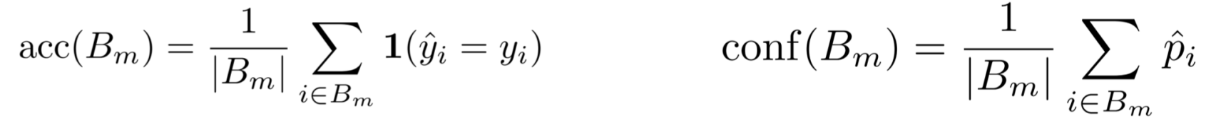
Define miscalibration
Perfectly calibrated model
Expected Calibrated Error (ECE)
ECE can be approximated by
where

Slide 8
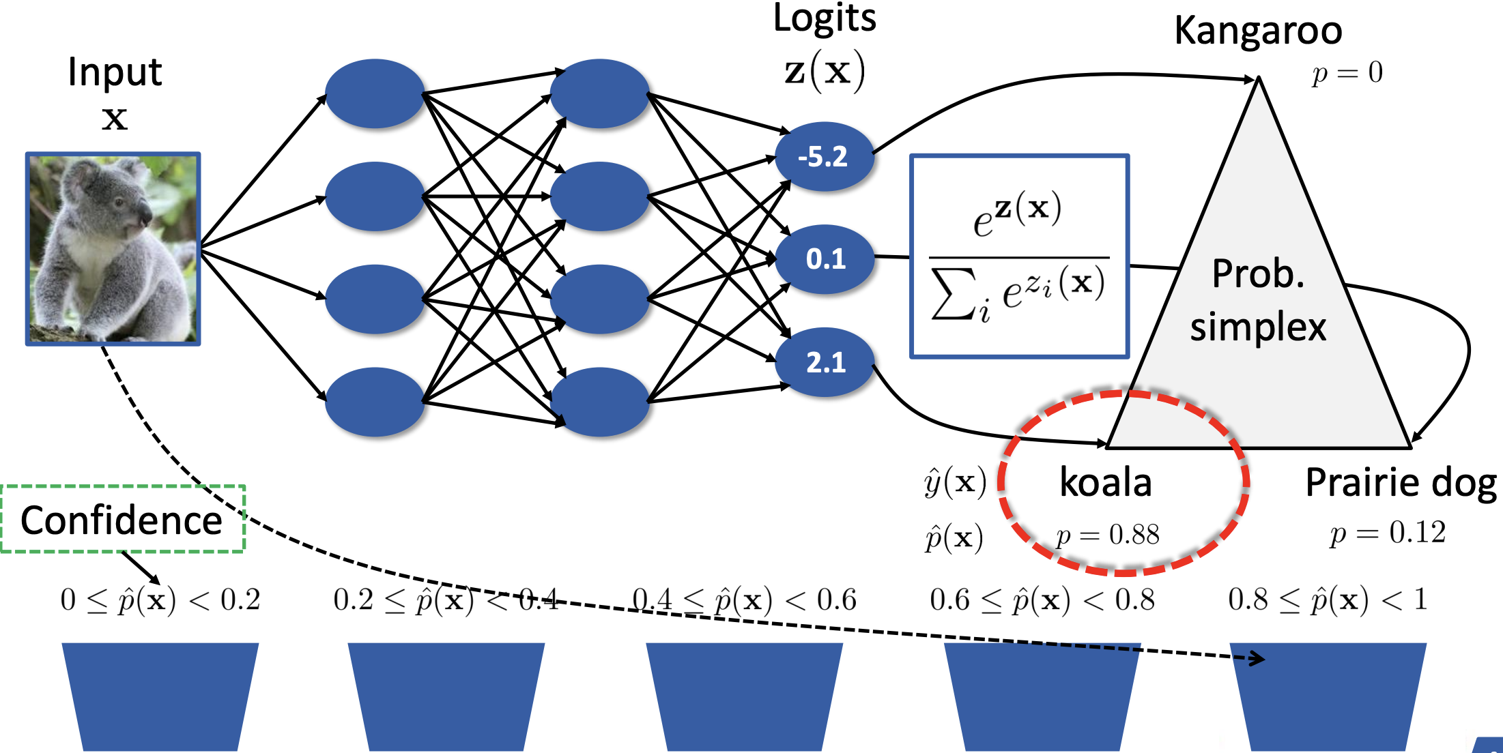
Measure miscalibration
Group by its prediction probability

Slide 9
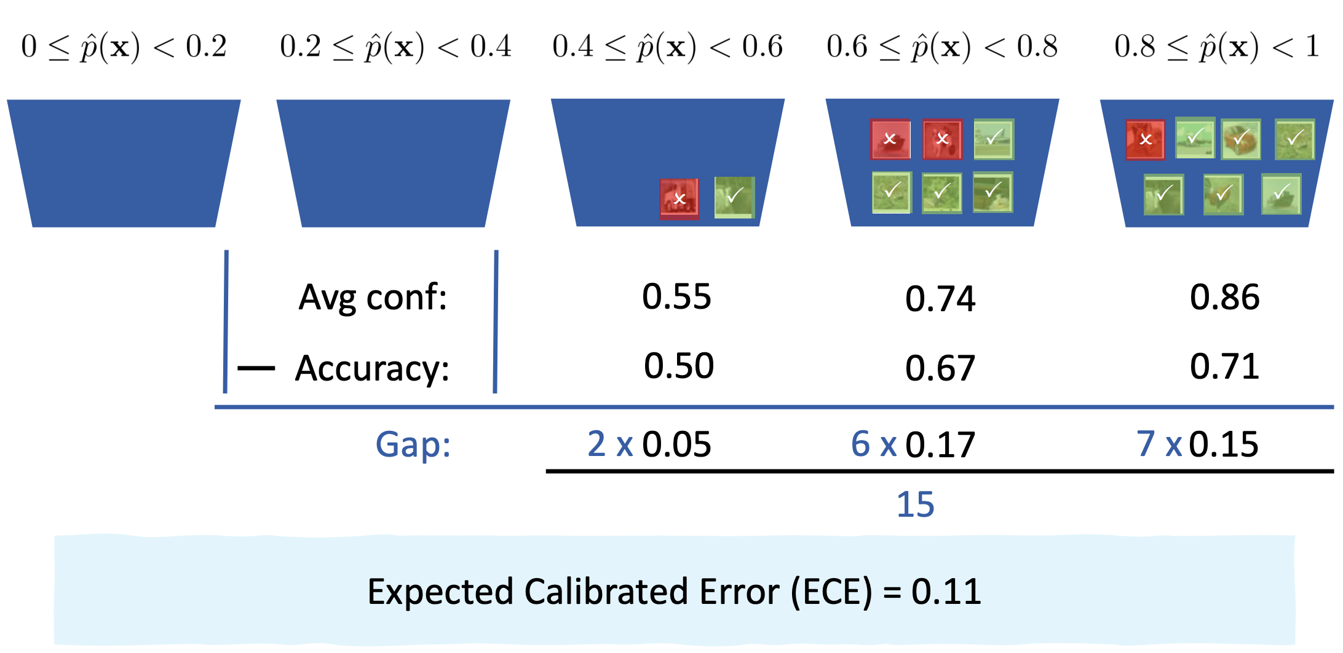
Measure miscalibration

Slide 10
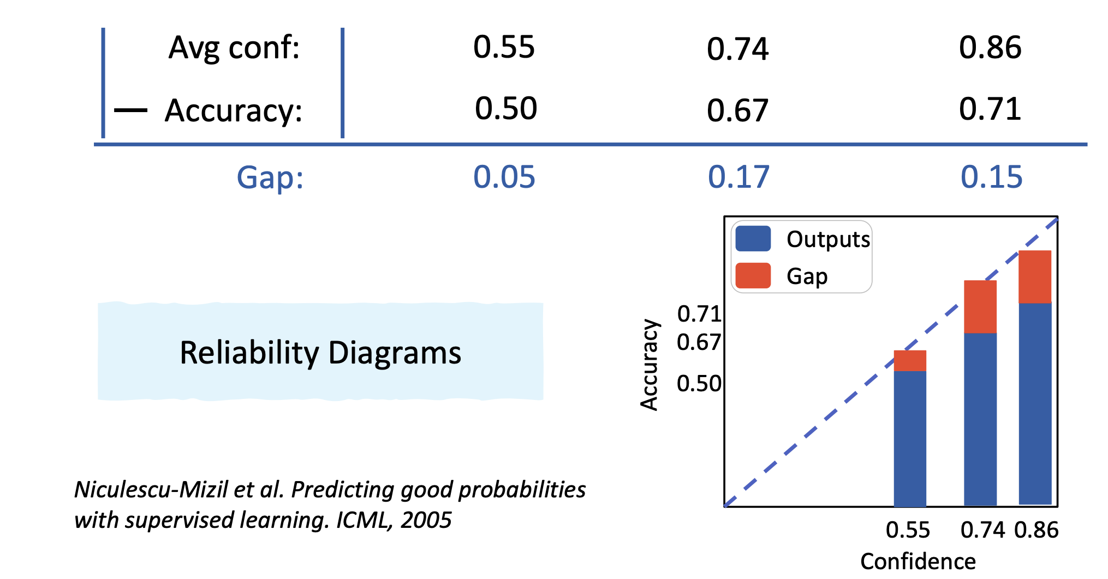
Visualize miscalibration
Niculescu-Mizil et al. Predicting good probabilities with supervised learning. ICML, 2005

Slide 11
The second question
What makes DNN mis-calibrated?

Slide 12
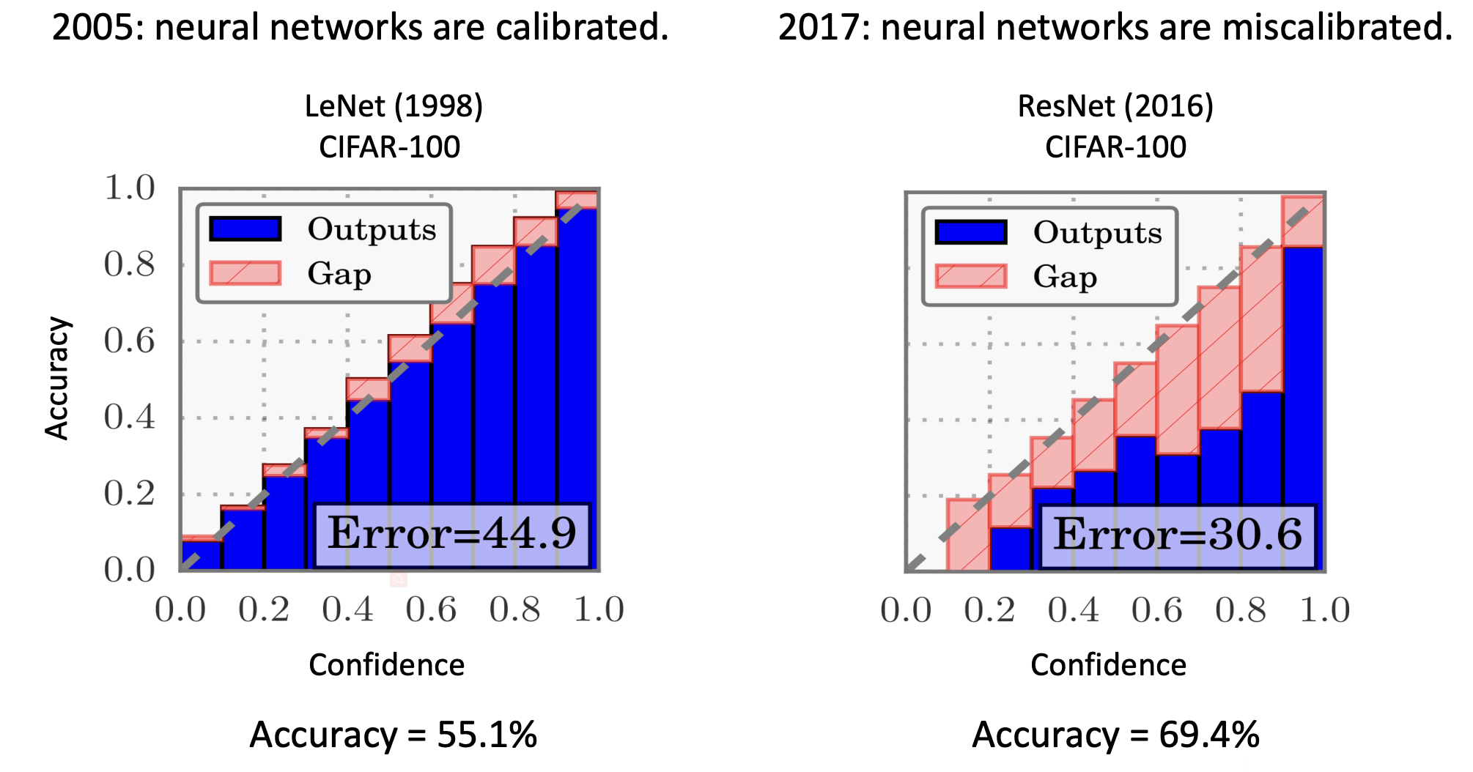
Neural network evaluation

Slide 13
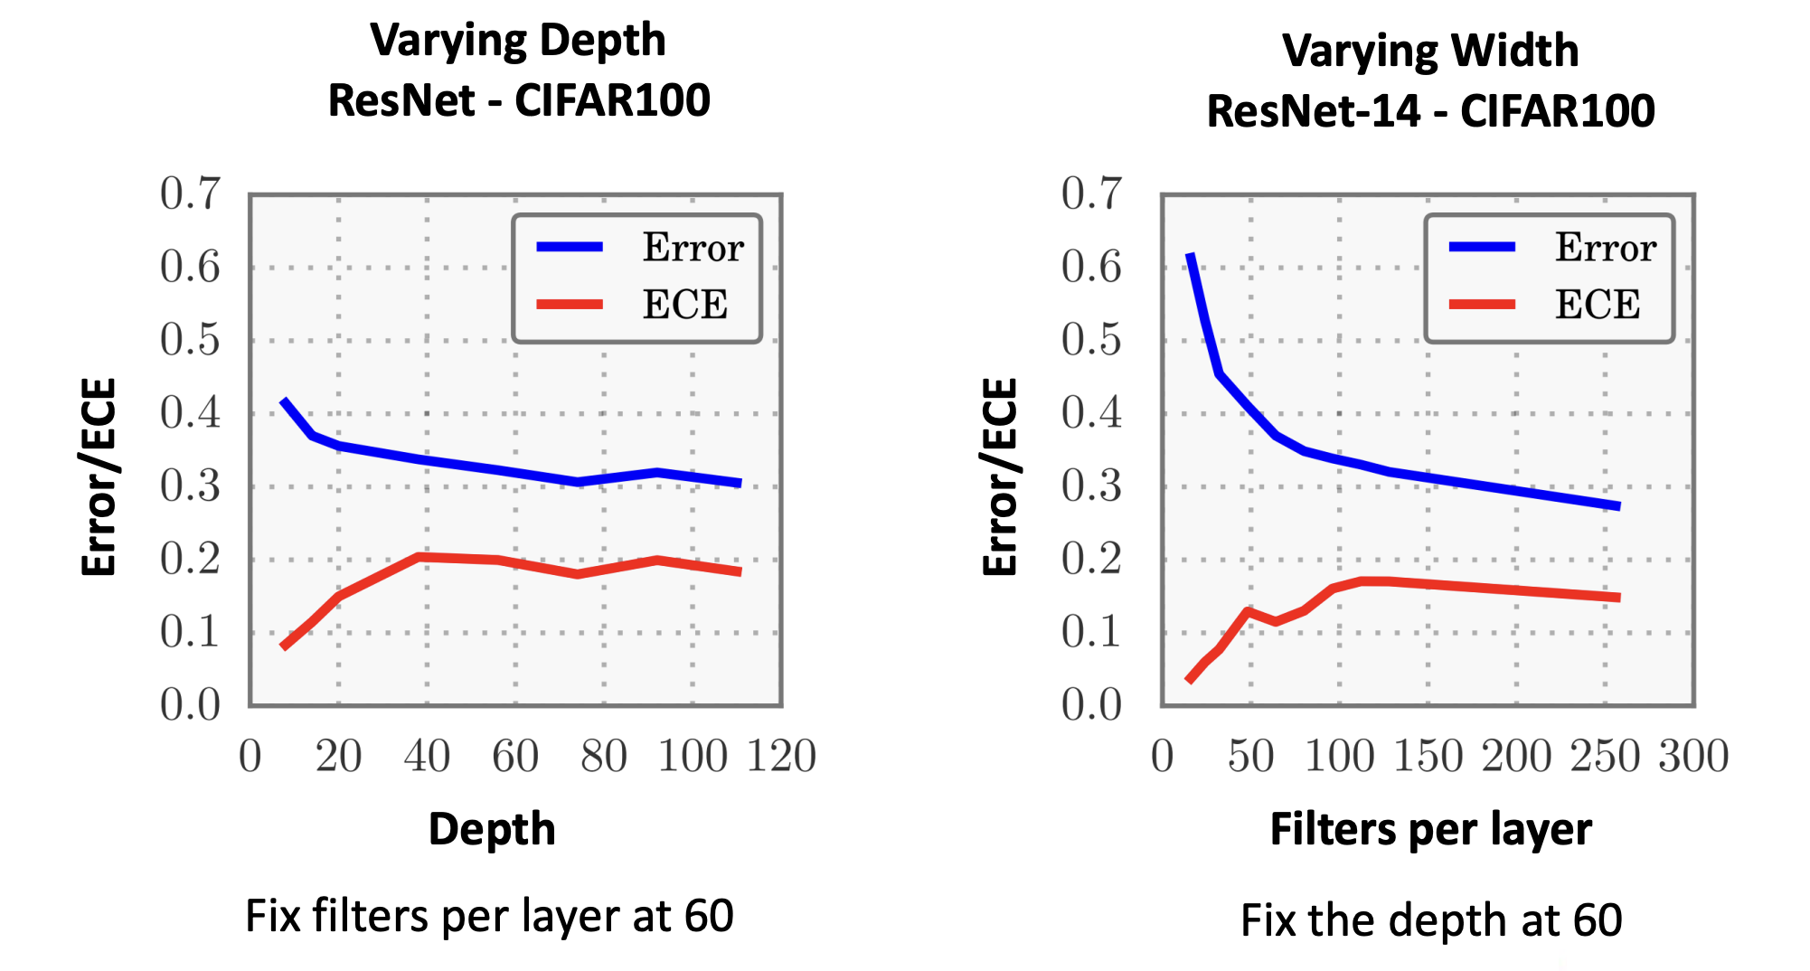
Increased network capacity

Slide 14
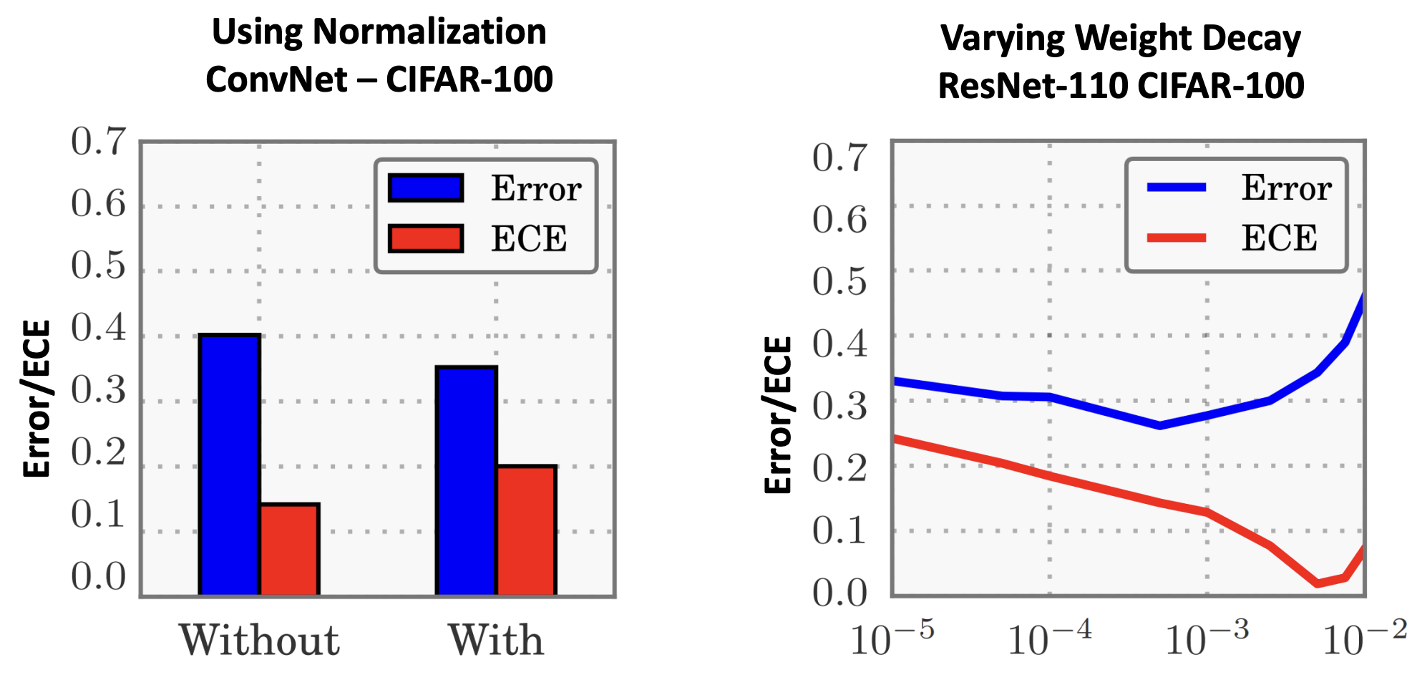
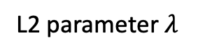
Batch normalization & Regularization
L2 parameter $λ$

Slide 15
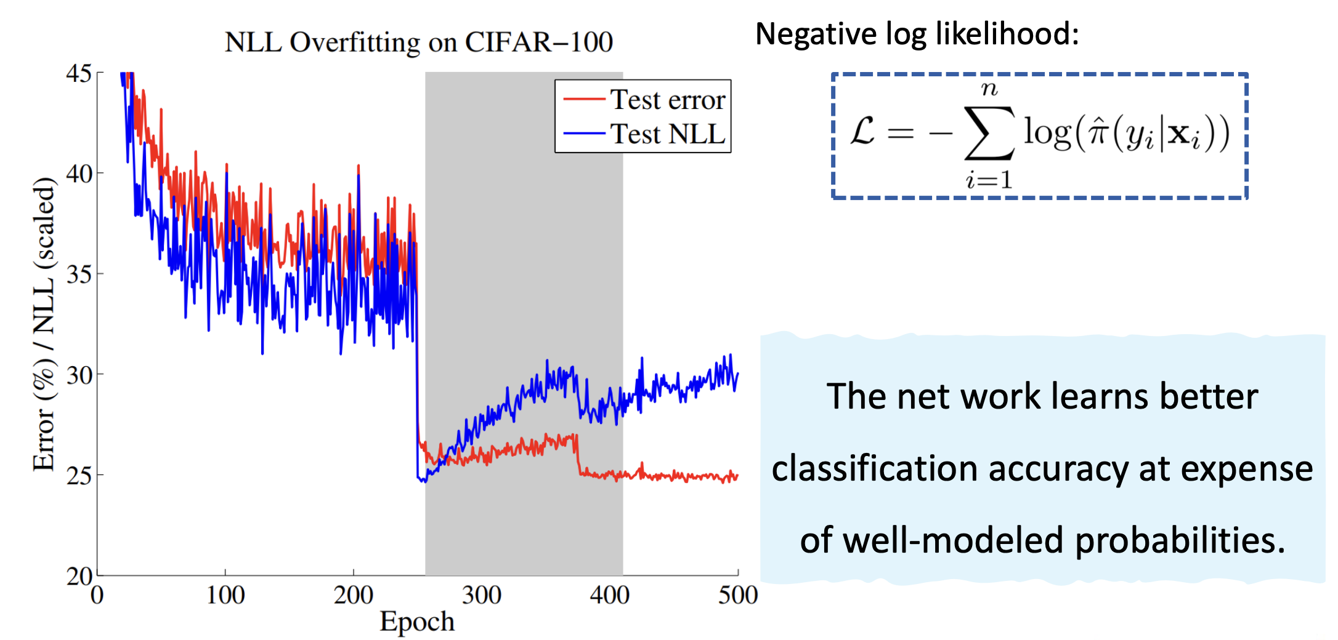
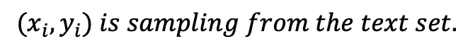
NLL overfitting
$${(x}_{i},y_{i}) is sampling from the text set.$$
Tuning learning rate

Slide 16
The third question
How can we correct miscalibration?

Slide 17
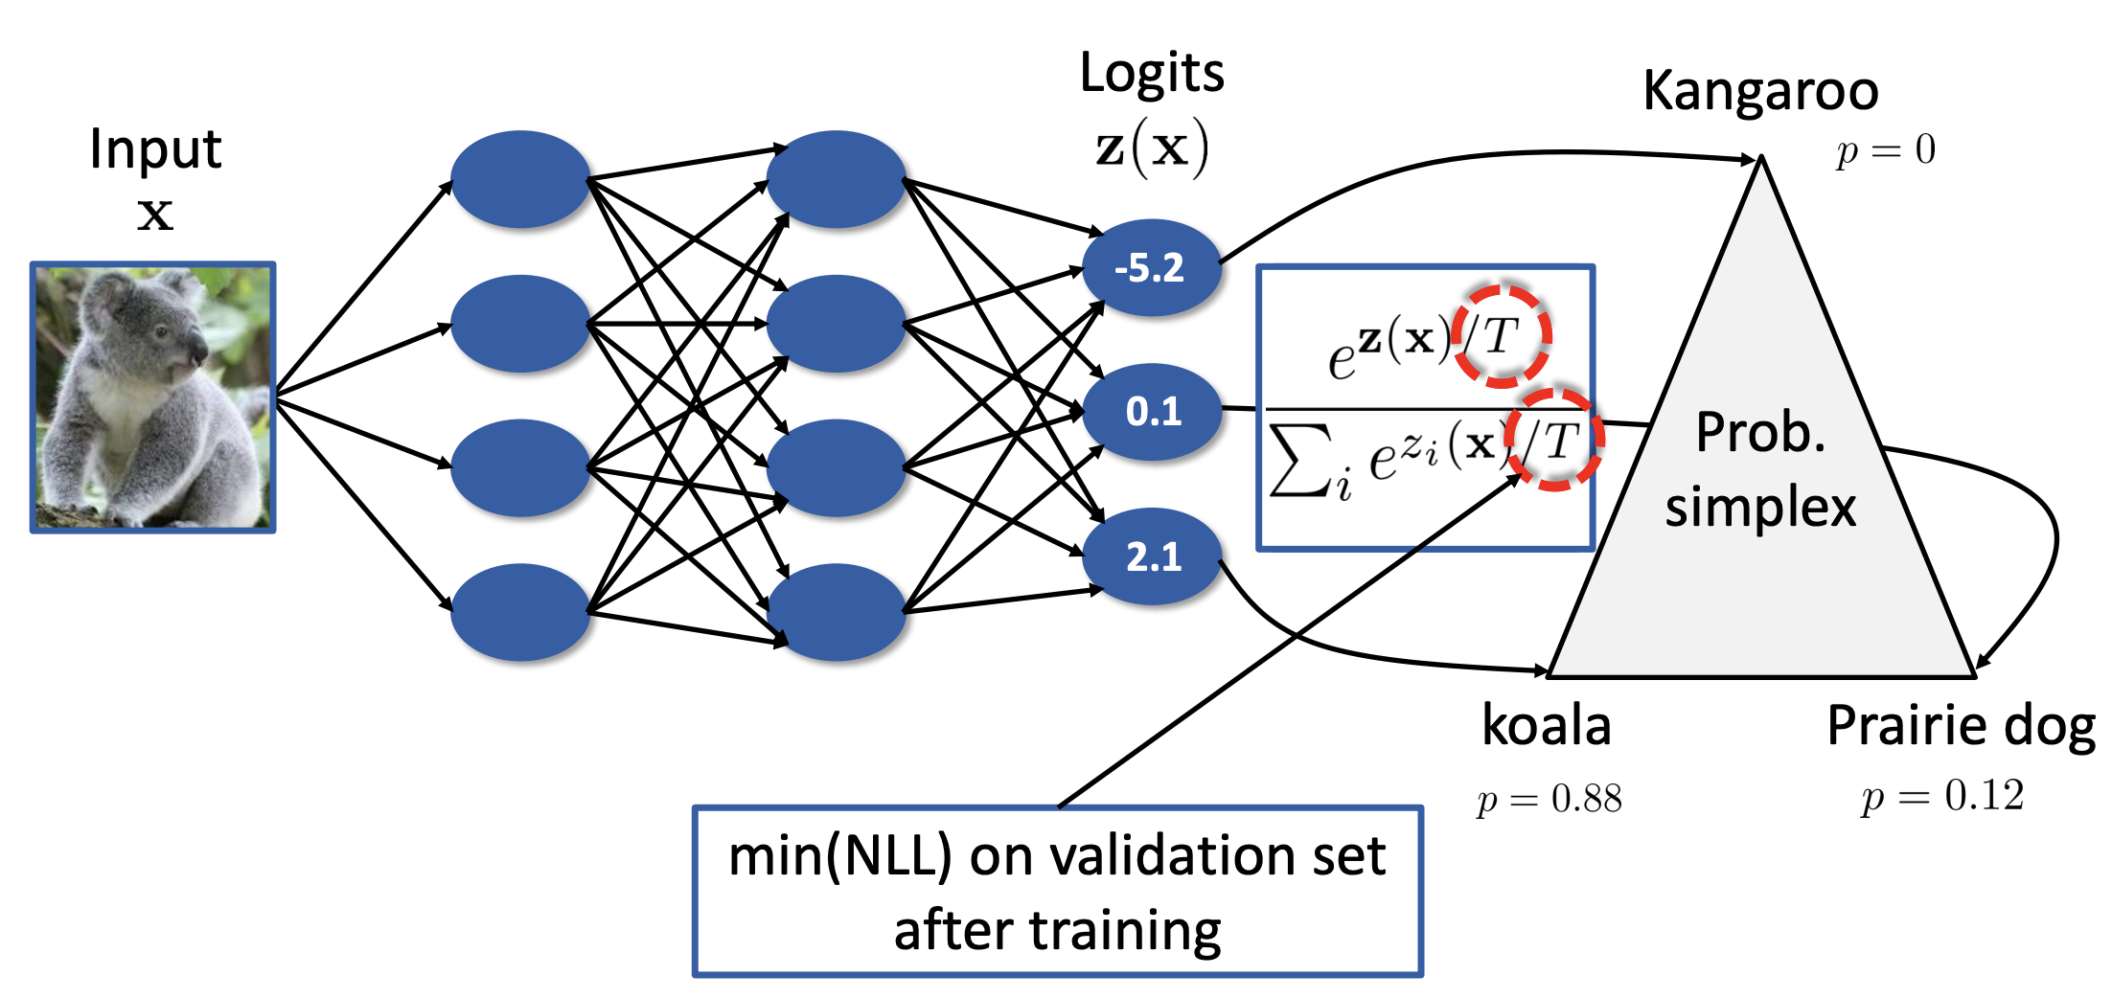
Temperature scaling
Temperature scaling does not affect the model’s accuracy.

Slide 18
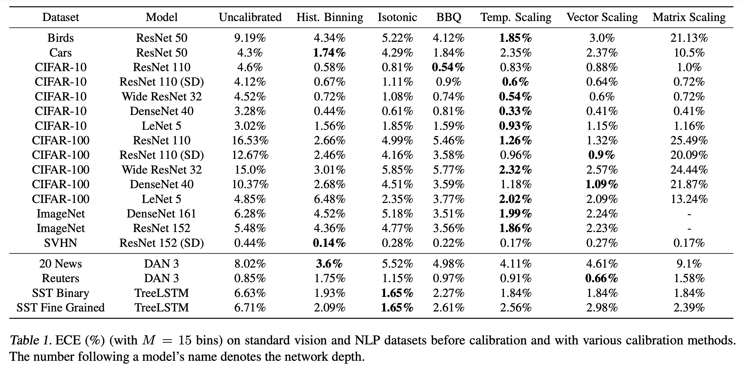
Experiments

Slide 19
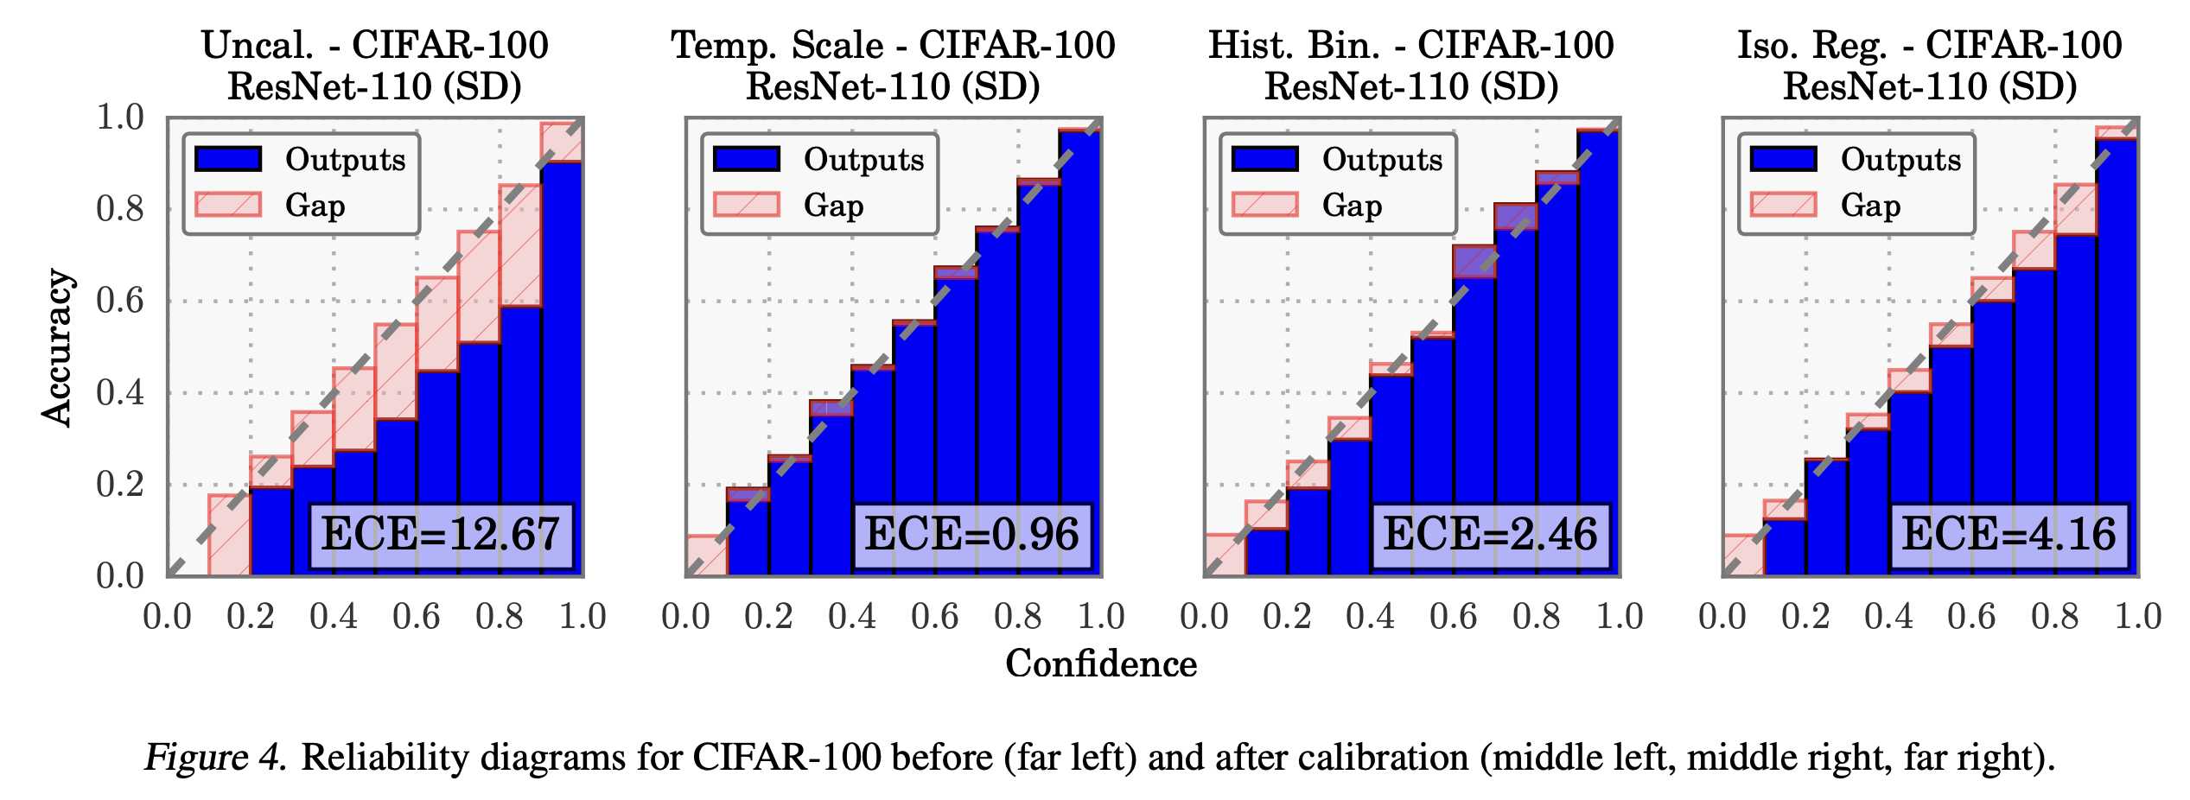
Experiments

Slide 20
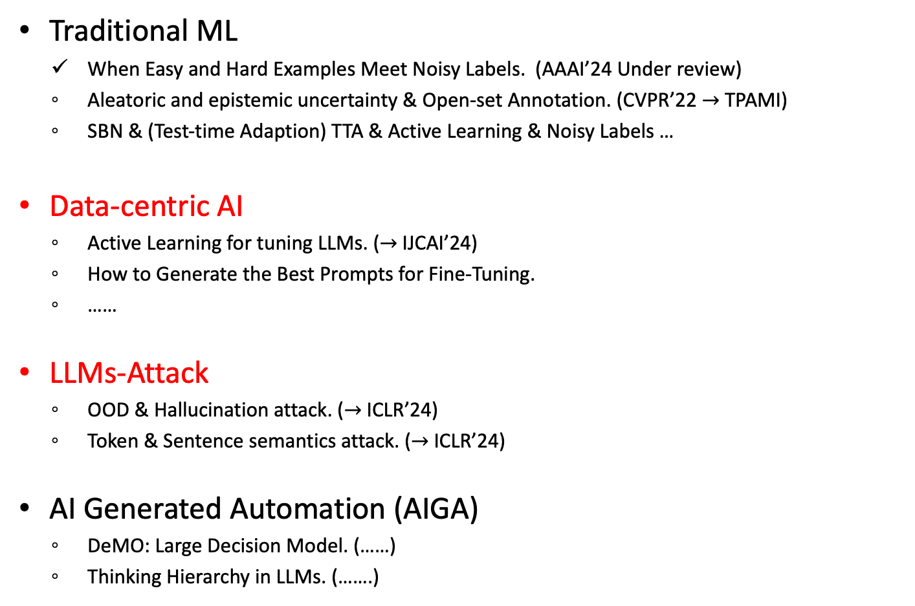
Awesome topics
Traditional ML
When Easy and Hard Examples Meet Noisy Labels. (AAAI’24 Under review)
Aleatoric and epistemic uncertainty & Open-set Annotation. (CVPR’22 $→$ TPAMI)
SBN & (Test-time Adaption) TTA & Active Learning & Noisy Labels …
Data-centric AI
Active Learning for tuning LLMs. ($→$IJCAI’24)
How to Generate the Best Prompts for Fine-Tuning.
……
LLMs-Attack
OOD & Hallucination attack. ($→$ICLR’24)
Token & Sentence semantics attack. ($→$ICLR’24)
AI Generated Automation (AIGA)
DeMO: Large Decision Model. (……)
Thinking Hierarchy in LLMs. (…….)

Slide 21
Thanks

